Slide 1
Qiskit Aqua
An introduction to quantum machine learning

Slide 2
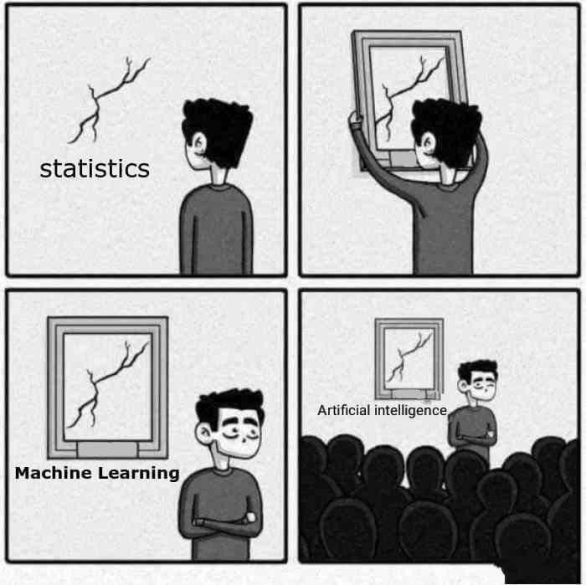
What even is (classical) machine learning?

Slide 3
Why do we need quantum machine learning?
Speedups
Memory
It complicates things

Slide 4
Why has classical ML blown up, but not QML?
Over enthusiastic college kids
The rise of the ML bro

Slide 5
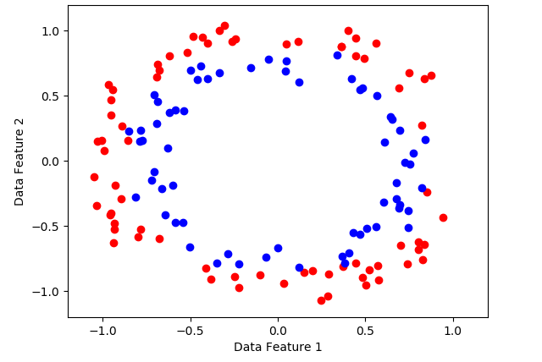
What even is a (classical) support vector machine?

Slide 6
What even is a (classical) support vector machine?

Slide 7
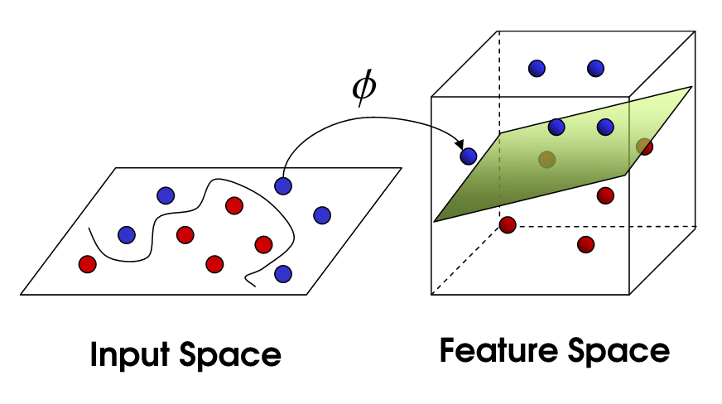
What even is a (classical) support vector machine?

Slide 8
Moving into the quantumverse
Why are classical SVMs not good enough?
Computing the kernel function is expensive
We can estimate the kernel quickly using a QC

